Slide 1

Machine Learning on Imbalanced Categorical Distributions
Thamme Gowda and Jonathan May
CORAL Group Meeting
June 24, 2021

Slide 2
Overview
Imbalanced Classification
Methods
- Data-based
- Objective-based
Experiments
- Image classification
- Mars images dataset
- Model and training
- Results
Discussion
Why should we care?
Next steps

Slide 3
Imbalanced Classification [1/2]
Classification problem where some classes occur more frequently than others Majority and minority classes; aka frequent and rare classes
Examples:
Cancer detection: Globally, ~1% of people have cancer If imbalance is 99:1, majority-class baseline models gets 99% accuracy without learning. Is it useful? No. Performance on minority class is also important
Image segmentation: Overwhelming number of background pixels than the foreground pixel classes Foreground classes are important
Natural language generation: Overwhelming number of stopword tokens than the content words Content words classes are important

Slide 4
Imbalanced Classification [2/2]
What is the problem? Without any special care, ML techniques achieve good performance on majority classes, but relatively poor performance on minority classes i.e. poor performance on the classes that are more important
Recently, we worked on evaluation metrics: → Macro-average: rare types are important too. NAACL2021
Next: How to improve performance on minority classes? → Machine learning on imbalanced categorical distributions
Note: Many benchmark datasets used by academia are balanced, but the real-world problems are very likely imbalanced. CIFAR-{10,100}, MNIST (nearly balanced), SNLI, XNLI, IMDbReview, DBPedia-14, ... Most datasets from tensorflow-datasets, torchtext, torchvision, huggingface-datasets are balanced

Slide 5
Imbalanced Learning Methods
Data-based methods
Sampling based methods
Random up-sample minority class(es)
Random down-sample majority class(es)
Augmentation methods
Synthetic Minority Oversample Technique
Just-add-more-examples →The law of diminishing return benefits minority classes more than majority classes
Objective-based methods
Weighted Cross Entropy with unequal weights
Focal Loss
Label Smoothing
⬅ Focusing on Objective-based methods.
Imbalance is inevitable in NLP (my focus). Attaining class balance via sampling and synthetic augmentation is hard.

Slide 6
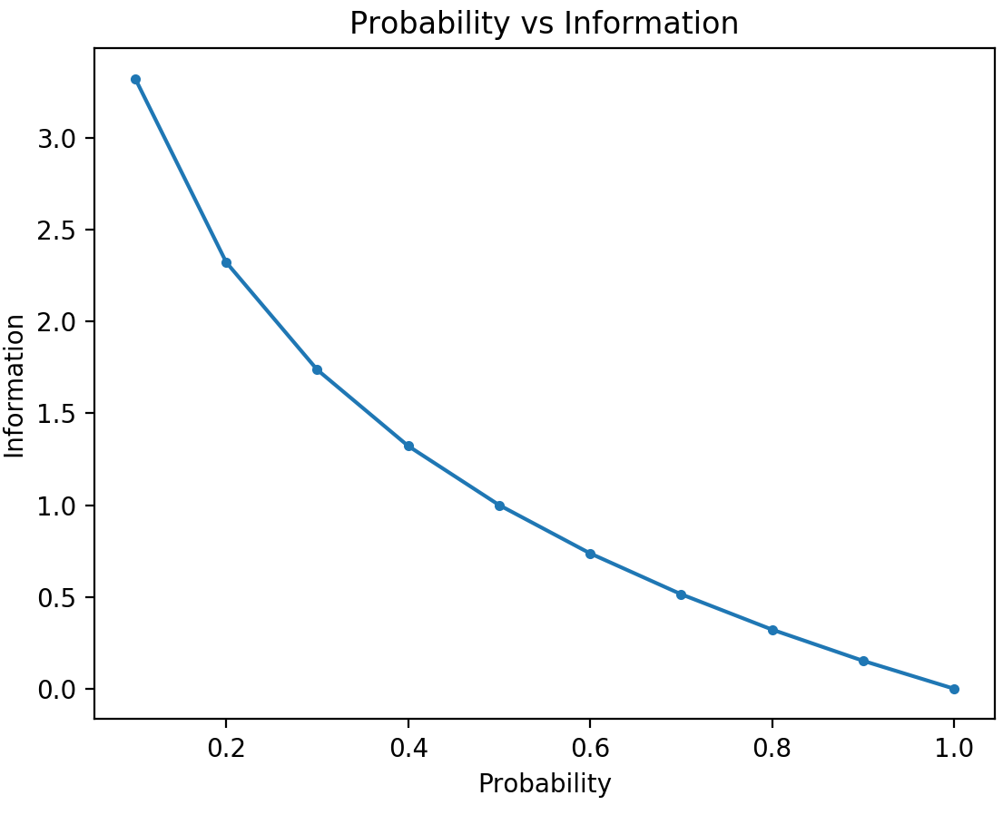
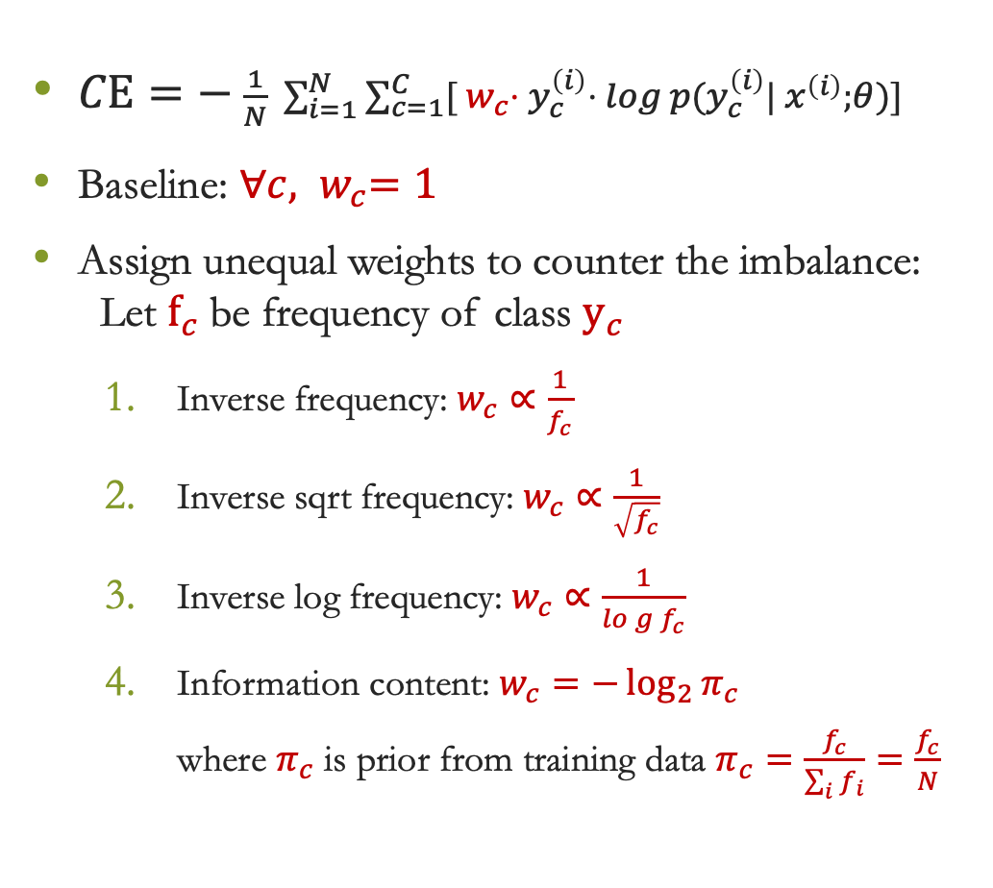
Weighted Cross Entropy
$CE=− \frac{1}{N} \sum_{i=1}^{N}{\sum_{c=1}^{C}{{[{ w}_{c}⋅ y}_{c}^{\left(i\right)}⋅} log p(y_{c}^{\left(i\right)}| x^{\left(i\right)};θ)]}$
Baseline: ${∀c, w}_{c}=1$
Assign unequal weights to counter the imbalance: Let $f_{c}$be frequency of class $y_{c}$
Inverse frequency: $w_{c}∝\frac{1}{f_{c}}$
Inverse sqrt frequency: $w_{c}∝\frac{1}{\sqrt{f_{c}}}$
Inverse log frequency: $w_{c}∝\frac{1}{log{f_{c}}}$
Information content: $w_{c}=−\log_{2}{π_{c}}$ where $π_{c}$ is prior from training data $π_{c}=\frac{f_{c}}{\sum_{i}{f_{i}}}=\frac{f_{c}}{N}$
Notes:
$1/x$ is too harsh, $1/\sqrt{x}$ is smooth and $1/\log\left(x\right)$ is smoother

Slide 7
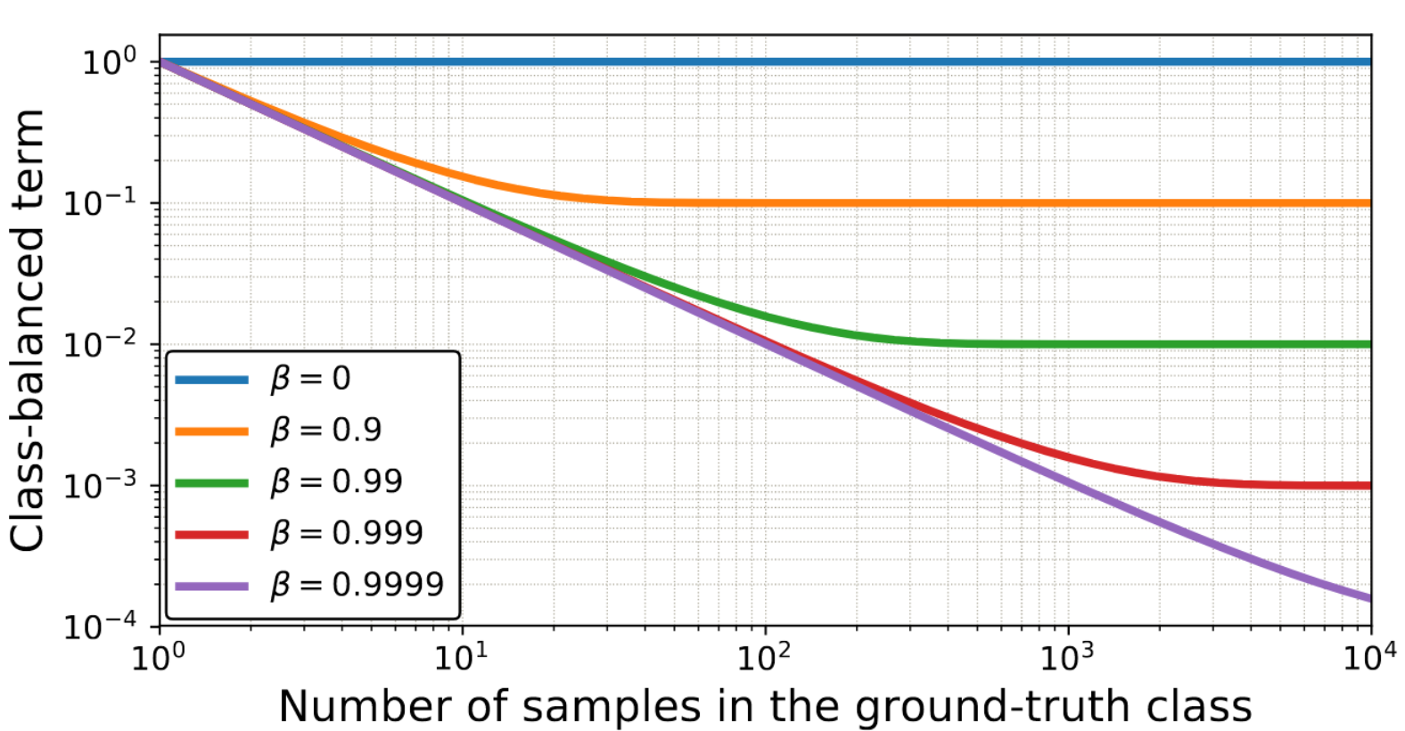
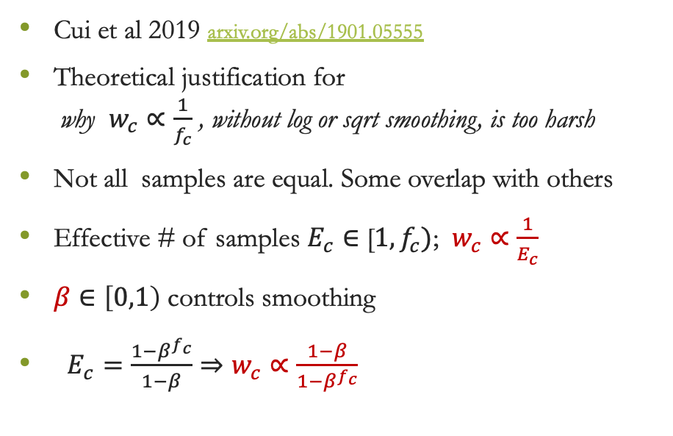
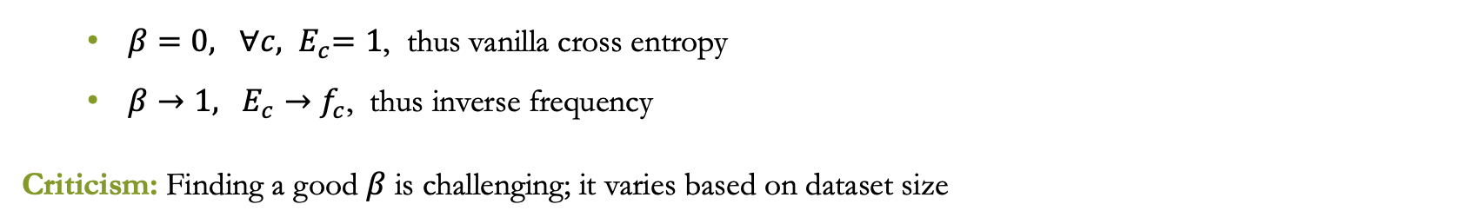
Effective Number of Samples
Cui et al 2019 arxiv.org/abs/1901.05555
Theoretical justification for why $w_{c}∝\frac{1}{f_{c}}$ , without log or sqrt smoothing, is too harsh
Not all samples are equal. Some overlap with others
Effective # of samples $E_{c}∈$ [$1, f_{c})$; $w_{c}∝\frac{1}{E_{c}}$
$β∈\left[0,1\right)$ controls smoothing
$E_{c}=\frac{1−β^{f_{c}}}{1−β}⇒w_{c}∝\frac{1−β}{1−β^{f_{c}}}$
$β=0, {∀c, E}_{c}=1$, thus vanilla cross entropy
$β→1, E_{c}→f_{c}$, thus inverse frequency
Criticism: Finding a good $β$ is challenging; it varies based on dataset size

Slide 8
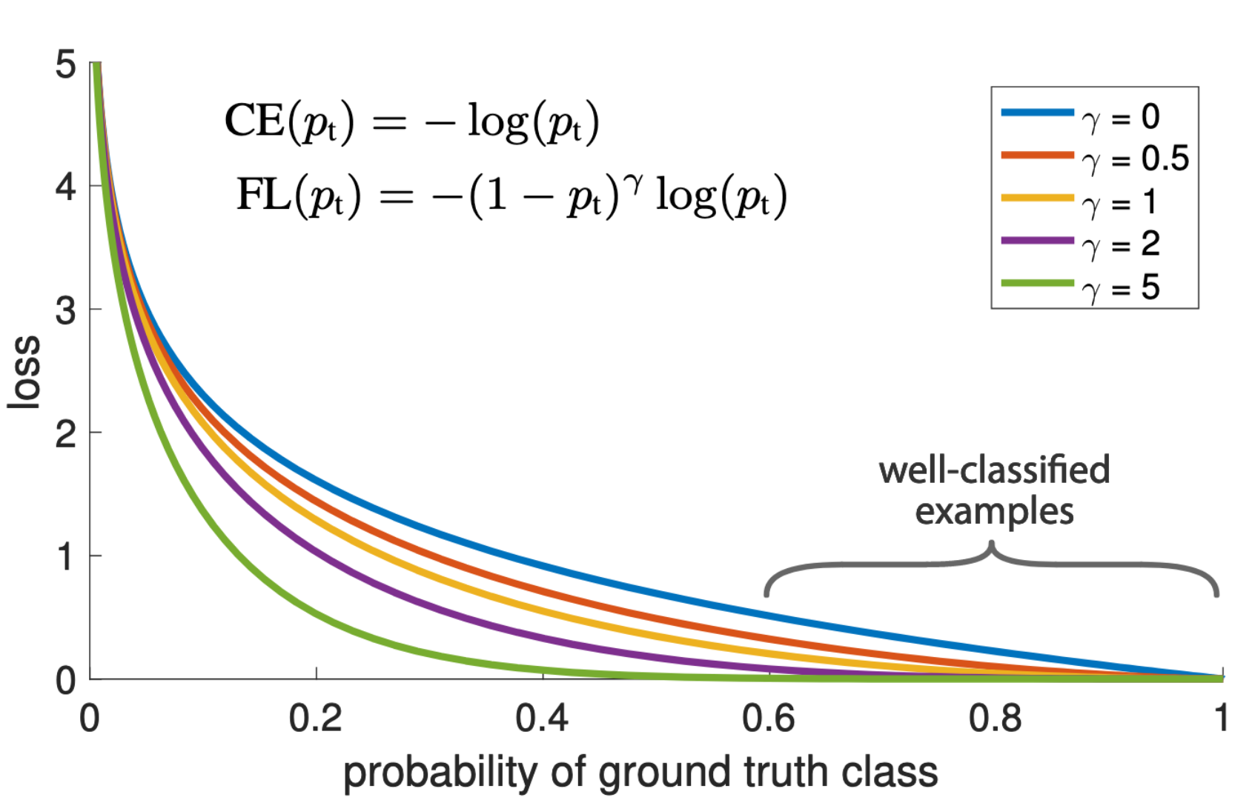
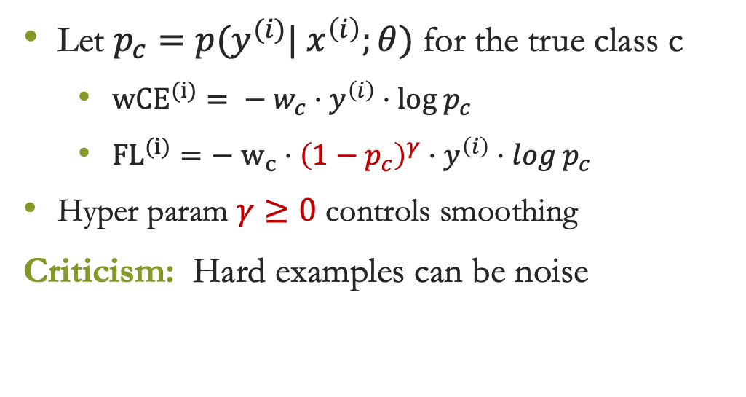
Focal Loss
Our assumption so far: minority classes are hard, majority classes are easy
But... majority classes may also have hard examples, and minority class may have easy examples
Focal Loss – Yin et al 2017 arxiv.org/abs/1708.02002
Key idea: relax penalty for easy-to-classify examples regardless of the class they belong to
Let $p_{c}=p(y^{(i)}| x^{\left(i\right)};θ)$ for the true class c
${wCE}^{(i)}= − w_{c}⋅y^{\left(i\right)}⋅log p_{c}$
${FL}^{(i)}=−$ $w_{c}⋅{\left(1−p_{c}\right)}^{γ}⋅y^{\left(i\right)}⋅log p_{c}$
Hyper param $γ≥0$ controls smoothing
Criticism: Hard examples can be noise

Slide 9
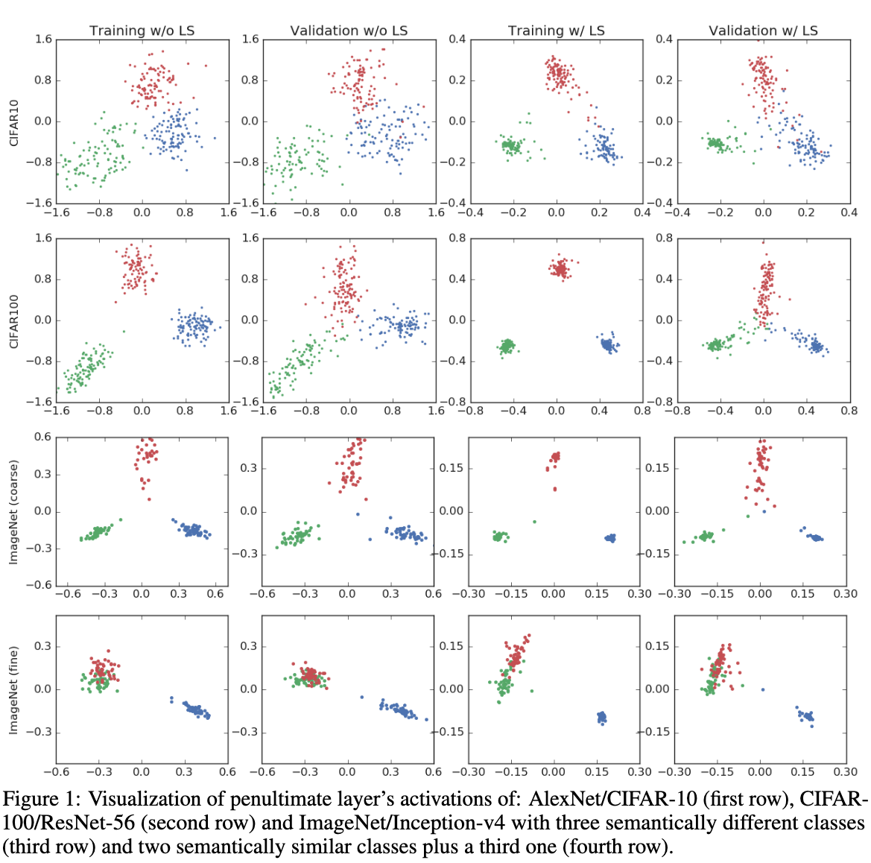
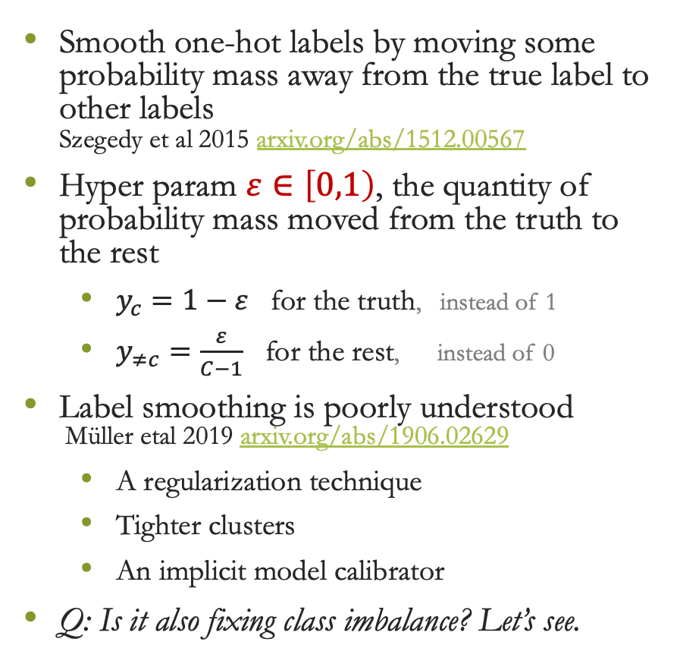
Label Smoothing
Smooth one-hot labels by moving some probability mass away from the true label to other labels Szegedy et al 2015 arxiv.org/abs/1512.00567
Hyper param $ε∈\left[0,1\right)$, the quantity of probability mass moved from the truth to the rest
$y_{c}=1−ε$ for the truth, instead of 1
$y_{≠c}=\frac{ε}{C−1}$ for the rest, instead of 0
Label smoothing is poorly understood Müller etal 2019 arxiv.org/abs/1906.02629
A regularization technique
Tighter clusters
An implicit model calibrator
Q: Is it also fixing class imbalance? Let’s see.

Slide 10
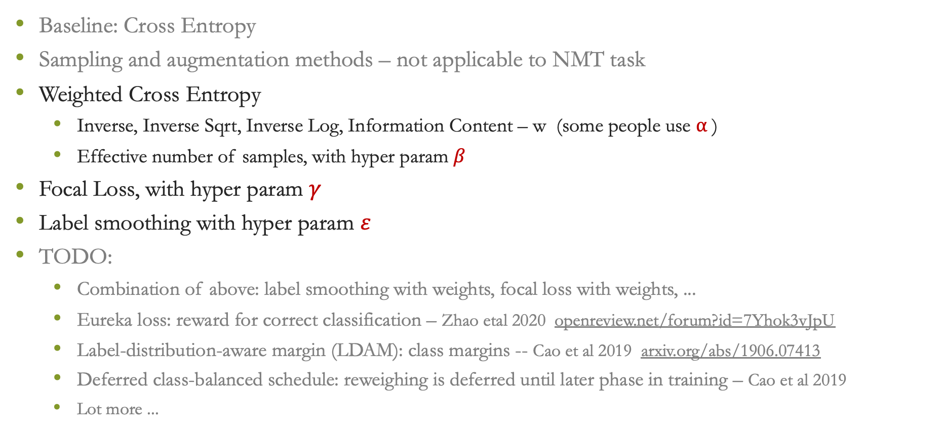
Summary of Methods
Baseline: Cross Entropy
Sampling and augmentation methods – not applicable to NMT task
Weighted Cross Entropy
Inverse, Inverse Sqrt, Inverse Log, Information Content – w (some people use ⍺ )
Effective number of samples, with hyper param $β$
Focal Loss, with hyper param $γ$
Label smoothing with hyper param $ε$
TODO:
Combination of above: label smoothing with weights, focal loss with weights, ...
Eureka loss: reward for correct classification – Zhao etal 2020 openreview.net/forum?id=7Yhok3vJpU
Label-distribution-aware margin (LDAM): class margins -- Cao et al 2019 arxiv.org/abs/1906.07413
Deferred class-balanced schedule: reweighing is deferred until later phase in training – Cao et al 2019
Lot more ...

Slide 11
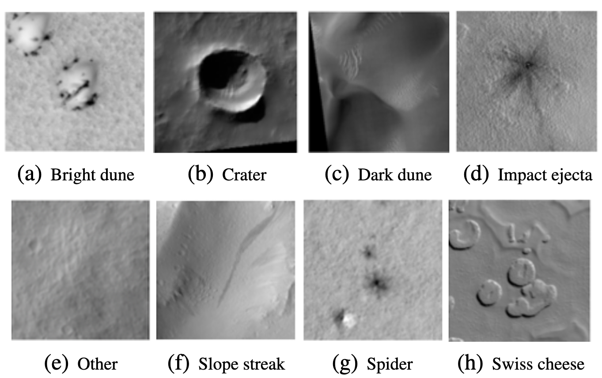
Experiment Setup
Class | Train Freq | Train % | Val Freq | Val %
Other | 40,019 | 81.71 | 11,221 | 79.16
Crater | 3,598 | 7.35 | 1,337 | 9.43
Bright Dune | 1,561 | 3.19 | 77 | 0.54
Swiss Cheese | 1,281 | 2.62 | 511 | 3.60
Slope Streak | 924 | 1.89 | 602 | 4.25
Spider | 637 | 1.30 | 217 | 1.53
Dark Dune | 616 | 1.26 | 84 | 0.59
Impact Ejecta | 343 | 0.70 | 126 | 0.89
Total | 48,979 | 100 | 14,175 | 100
Task: Image Classification
Dataset:
High Resolution Imaging Science Experiment (HiRISE) v3.2 -- Images taken from Mars satellites -- Wagstaff et al 2021 (JPL)
8 classes, naturally imbalanced
Model:
ResNeXt -- torchvision.models.resnext50_32x4d()
Last layer is adapted to 8 classes
Training:
Hyper params based on best validation MacroF1
Weights: random initialization Optimizer: Adam lr: 0.0005, betas: [0.9, 0.999] Trained until convergence

Slide 12
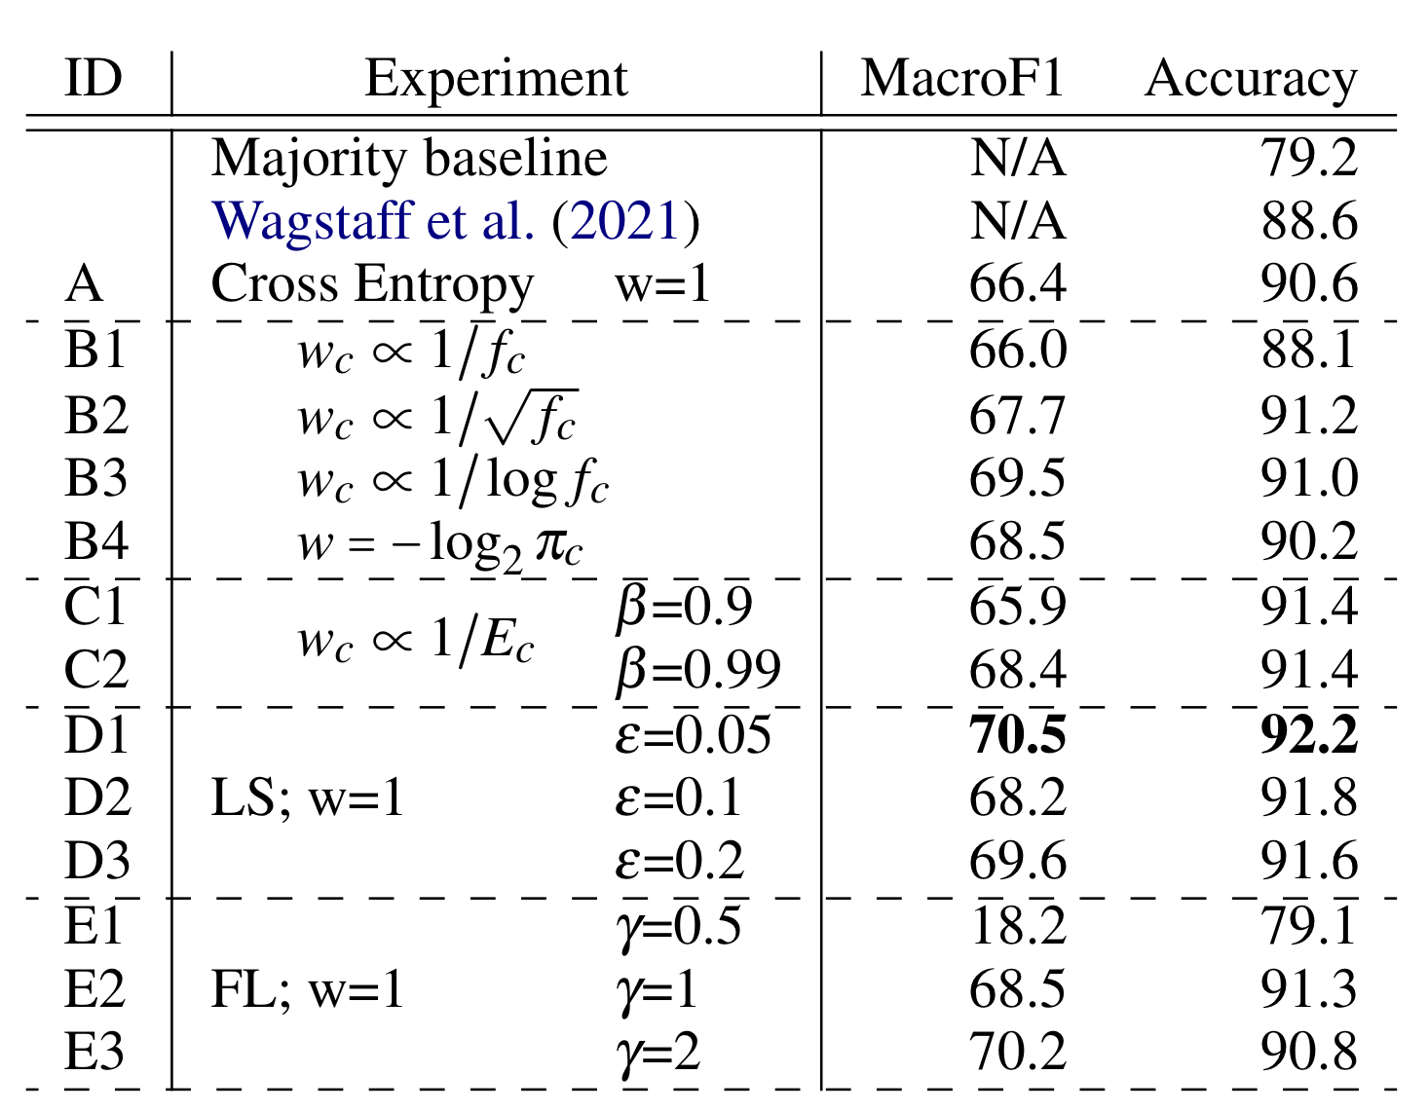
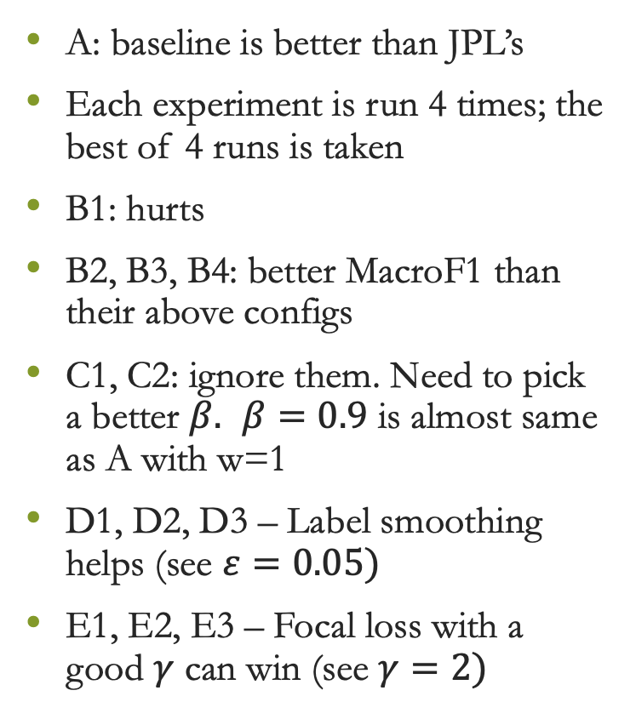
Results: Validation Set
A: baseline is better than JPL’s
Each experiment is run 4 times; the best of 4 runs is taken
B1: hurts
B2, B3, B4: better MacroF1 than their above configs
C1, C2: ignore them. Need to pick a better $β.$ $β=0.9$ is almost same as A with w=1
D1, D2, D3 – Label smoothing helps (see $ε=0.05)$
E1, E2, E3 – Focal loss with a good $γ$ can win (see $γ=2)$
TODO: combine label smoothing with others combine focal loss with weights

Slide 13
Validation Set F1 Measures
Promising results
Improvements in MacroF1 and Accuracy
A: baseline CE B: wCE inv_freq, inv_sqrt, inv_log , info_cont C: effective # of samples D: label smoothing E: focal loss
Class | Train% | A | B1 | B2 | B3 | B4 | C1 | C2 | D1 | D2 | D3 | E2 | E3
Other | 81.7 | 94.6 | 93.1 | 95.1 | 94.9 | 94.3 | 95.1 | 95.4 | 95.6 | 95.4 | 95.3 | 95.0 | 94.7
Crater | 7.3 | 78.2 | 75.3 | 79.2 | 79.5 | 76.3 | 79.1 | 80.4 | 78.9 | 80.9 | 78.2 | 80.4 | 75.9
Bright Dune | 3.2 | 64.7 | 74.4 | 65.4 | 58.5 | 75.0 | 55.3 | 76.5 | 84.1 | 85.0 | 65.2 | 74.9 | 83.1
Swiss Cheese | 2.6 | 87.7 | 90.7 | 92.8 | 92.0 | 92.1 | 90.7 | 90.2 | 93.7 | 90.4 | 93.3 | 89.4 | 87.7
Slope Streak | 1.9 | 68.9 | 61.6 | 72.8 | 72.6 | 72.3 | 74.9 | 71.3 | 75.1 | 73.4 | 73.6 | 64.7 | 67.7
Spider | 1.3 | 59.7 | 65.0 | 66.1 | 66.5 | 69.6 | 60.1 | 61.1 | 65.0 | 60.2 | 56.6 | 68.4 | 74.1
Dark Dune | 1.3 | 58.1 | 36.3 | 49.8 | 54.2 | 62.8 | 47.7 | 54.3 | 52.4 | 60.3 | 52.4 | 47.7 | 51.8
Impact Ejecta | 0.7 | 19.2 | 31.5 | 20.1 | 37.6 | 5.9 | 24.1 | 17.8 | 18.8 | 0.0 | 42.3 | 27.4 | 26.9
MacroF1 |  | 66.4 | 66.0 | 67.7 | 69.5 | 68.5 | 65.9 | 68.4 | 70.4 | 68.2 | 69.6 | 68.5 | 70.2
Accuracy |  | 90.6 | 88.1 | 91.2 | 91.0 | 90.2 | 91.4 | 91.4 | 92.2 | 91.8 | 91.6 | 91.2 | 90.8

Slide 14
Last Slide
Next steps
TODO1: try the combinations : label smoothing with weights
TODO2: try re-weighting based on mini-batch frequencies instead of whole batch (i.e., dataset)
Macro averaged loss: group by class and then average
TODO3: Eureka loss, and other works I may have missed
TODO4: Text classification
TODO4: Machine translation
Discussion -- any other suggestions?
Thanks

Slide 15

From Social Sciences ...
Nature is imbalanced; even the societies are imbalanced There are attempts to address these imbalances Some methods are controversial
“Affirmative action: set of policies and practices within a govt or org seeking to increase the representation of particular groups based on their gender, race, sexuality, creed or nationality in areas in which they are underrepresented such as education and employment” -- Wikipedia.org
Quota system: certain percentage of govt jobs, political positions, and school vacancies reserved for members of certain groups
E.g.,1: Reservation system in India
E.g.,2: USA employment-based immigration: 7% per-country ceiling
Preference or special consideration to minoritized groups in selection processes
E.g., scholarships for students
Imbalance is everywhere in nature, people, society ...

Slide 16
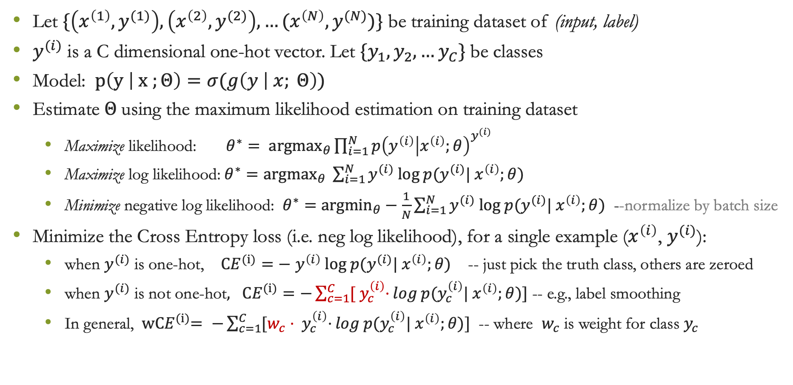
Cross Entropy
Let $\{\left(x^{\left(1\right)},y^{(1)}\right), \left(x^{\left(2\right)},y^{(2)}\right), …(x^{\left(N\right)},y^{(N)})\}$ be training dataset of (input, label)
$y^{(i)}$ is a C dimensional one-hot vector. Let ${\{y}_{1},y_{2},…y_{C}\}$be classes
Model: $p\left(y | x ;Θ\right)=σ(g\left(y | x; Θ\right))$
Estimate $Θ$using the maximum likelihood estimation on training dataset
Maximize likelihood: ${θ^{∗}= argmax}_{θ}\prod_{i=1}^{N}{p{\left(y^{\left(i\right)} | x^{\left(i\right)};θ\right)}^{y^{(i)}} }$
Maximize log likelihood:$θ^{∗}={argmax}_{θ} \sum_{i=1}^{N}{y^{(i)} log p(y^{(i)}| x^{\left(i\right)};θ)}$
Minimize negative log likelihood: $θ^{∗}=$ ${argmin}_{θ}−\frac{1}{N}\sum_{i=1}^{N}{y^{(i)} log p(y^{(i)}| x^{\left(i\right)};θ)}$ --normalize by batch size
Minimize the Cross Entropy loss (i.e. neg log likelihood), for a single example ($x^{\left(i\right)}$, $y^{(i)}$):
when $y^{(i)}$ is one-hot, ${CE}^{(i)}=−$ $y^{\left(i\right)} log p(y^{(i)}| x^{\left(i\right)};θ)$ -- just pick the truth class, others are zeroed
when $y^{(i)}$ is not one-hot$, {CE}^{(i)}=−\sum_{c=1}^{C}{{[ y}_{c}^{\left(i\right)}⋅}log p(y_{c}^{\left(i\right)}| x^{\left(i\right)};θ)]$ -- e.g., label smoothing
In general, ${ wCE}^{(i)}= −\sum_{c=1}^{C}{{[w_{c}⋅ y}_{c}^{\left(i\right)}⋅}log p(y_{c}^{\left(i\right)}| x^{\left(i\right)};θ)]$ -- where $w_{c}$ is weight for class $y_{c}$

